Slide 1

SOCCER COMMENTARY MINING
Natural Language Processing
Project 1 proposal
Szymon Maksymiuk
Adam Narożniak
Władysław Olejnik
Patryk Świątek

Slide 2
Why is it interesting?

Slide 3

Why is it interesting?
Unexplored – we have not found previous work about analysing boradcast's transcriptions.
Accessible – everyone at least one has seen a football match and knows basic rules.
Challenging – data from three different sources – audio, text and tabular events.
Part of the bigger picture – chance to contribiute in a field where recent years were marked by rapid introduction of various statistical approches.

Slide 4
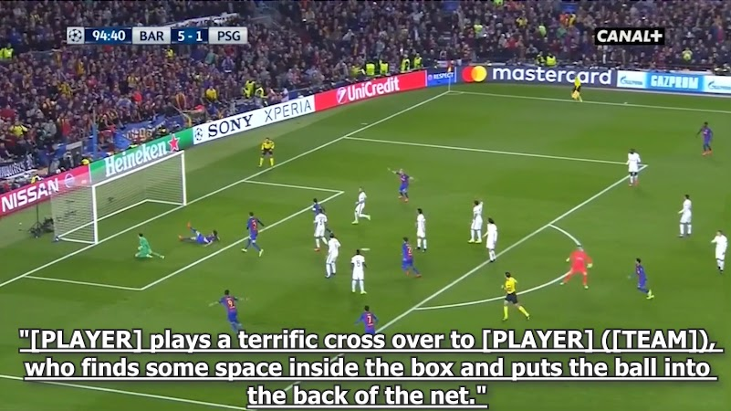
Why is it interesting?

Slide 5
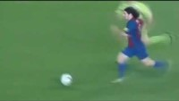
Why is it interesting?

Slide 6
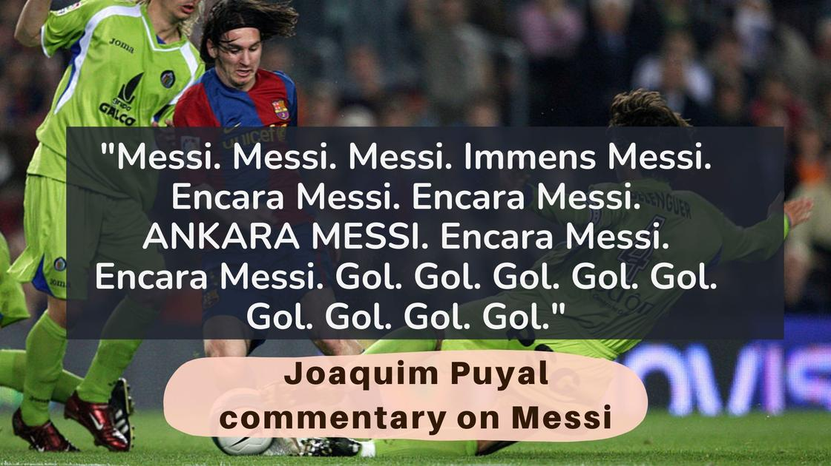
Why is it interesting?

Slide 7
Dataset

Slide 8
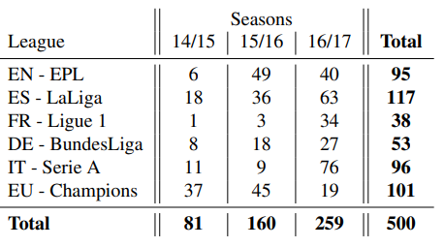
Soccernet
Opensource dataset.
500 games from the main European Championships.
Two untrimmed videos for one match (each for one half period).
An average of 13 labels per match:
Goal
Yellow/Red Card
Substitution
Exact minute of the match for each label.

Slide 9
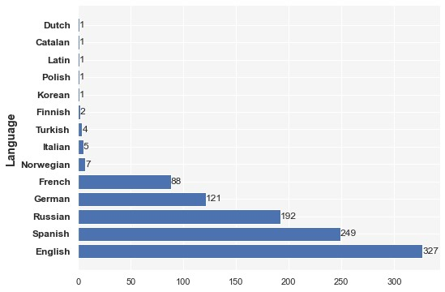
Language

Slide 10
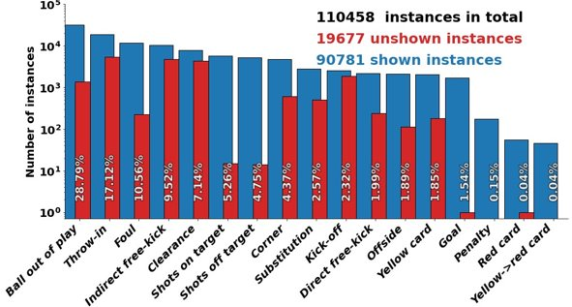
Soccernet-v2
Updated version of SoccerNet.
17 types of labels instead of 3.
An average of 221 labels per match (17 times more than for the previous version).

Slide 11
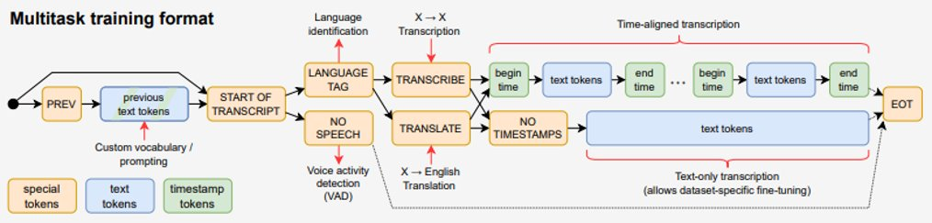
TRANSCRIPTS GENERATION: WHISPER
ASR model developed by OpenAI.
Transformer encoder-decoder framework.
Trained on different speech processing tasks:
multilingual speech recognition,
speech translation,
spoken language identification,
voice activity detection.

Slide 12
Research questions

Slide 13
Research questions
How well does the tabulated data we have, explain the estimated sentiment?
Statistical differences between lexical and ML approaches?
Can emotion intensification serve as an indicator of an important event?
What are the differences between sentiment from text and emotion from audio?
Do we really need audio data to spot interesting relationships? Is text alone not enough?
Do commentators of different nationalities react differently to the same events during a match?
How much and for how long do emotions intensify after important events in a match?
Can emotion intensification serve as an indicator of a future important event?

Slide 14
Project Approach

Slide 15
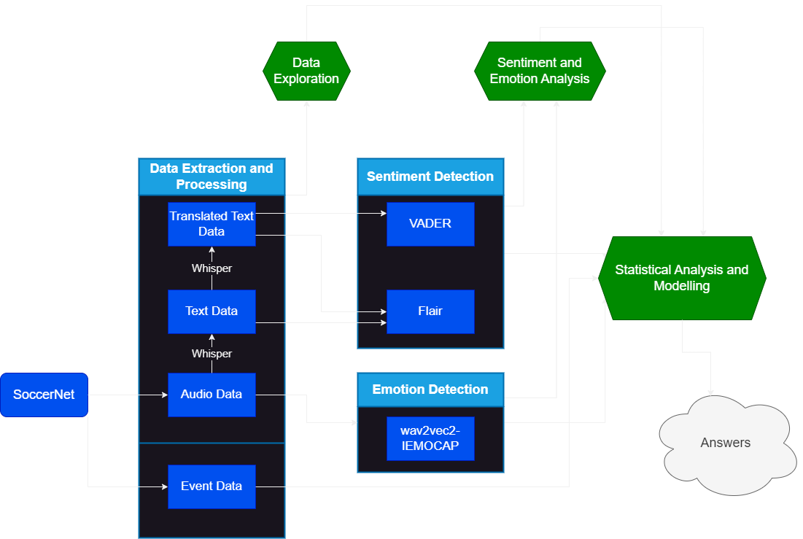
PROject approach

Slide 16
Preliminary Data Exploration

Slide 17
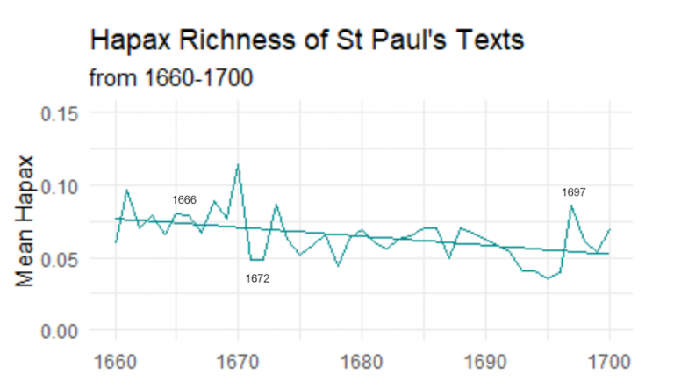
Preliminary Data Exploration
Tokens vs types analysis
Average statement length acorss languages
Filtering proper names
Words repetition and stopwords count
Overall language complexity:
Lexical readability (Flesch-Kinacid)
Lexical richness (TTR, Hapax richness)

Slide 18
SENTIMENT ANALYSIS

Slide 19
Lexicon-based "models"
LEXICON = DICTIONARY
Pros:
Interpretable
Cons:
Creation is time consuming (manual creation)
Dictionary size limited by the design
Based on expert knowledge

Slide 20
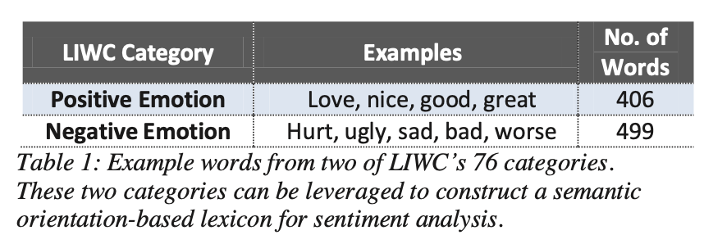
semantic orientation lexicons (POLARITY-BASED)
Model | Example | Scores
POLARITY-BASED | This pass is good. | +1
POLARITY-BASED | This pass is amazing. | +1
POLARITY-BASED | This pass is not bad. | -1

Slide 21
sentiment intensity lexicons (valence-based)
Model | Example | Scores
VALENCE-BASED | This pass is good. | +0.5
VALENCE-BASED | This pass is amazing. | +1.5
VALENCE-BASED | This pass is not bad. | -1.0

Slide 22
Context aware lexicons
Model | Example | Scores
CONTEXT AWARE | This pass is good. | +0.5
CONTEXT AWARE | This pass is amazing. | +1.5
CONTEXT AWARE | This pass is not bad. | +1.0

Slide 23
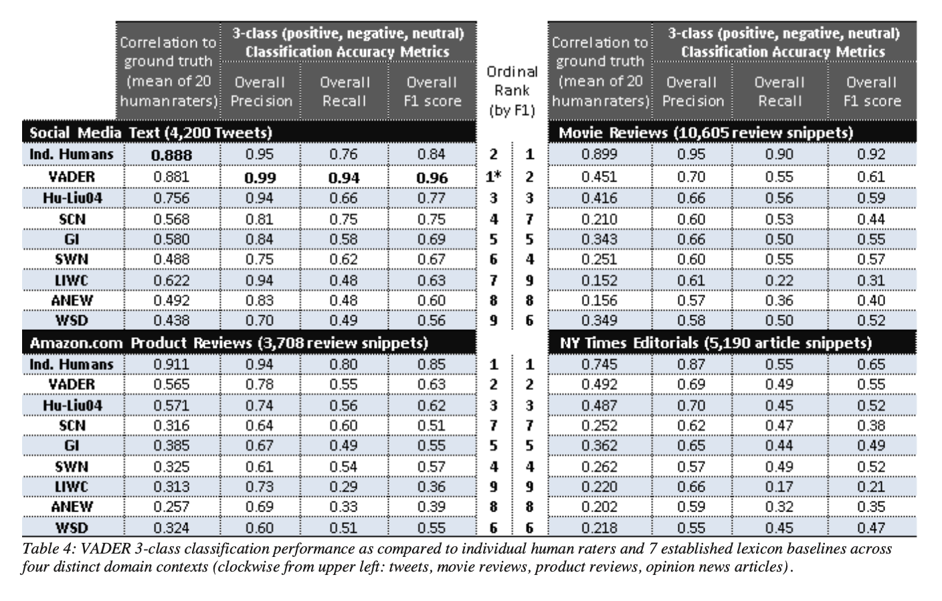
VADER
Lexicon-based
Rule-base

Slide 24
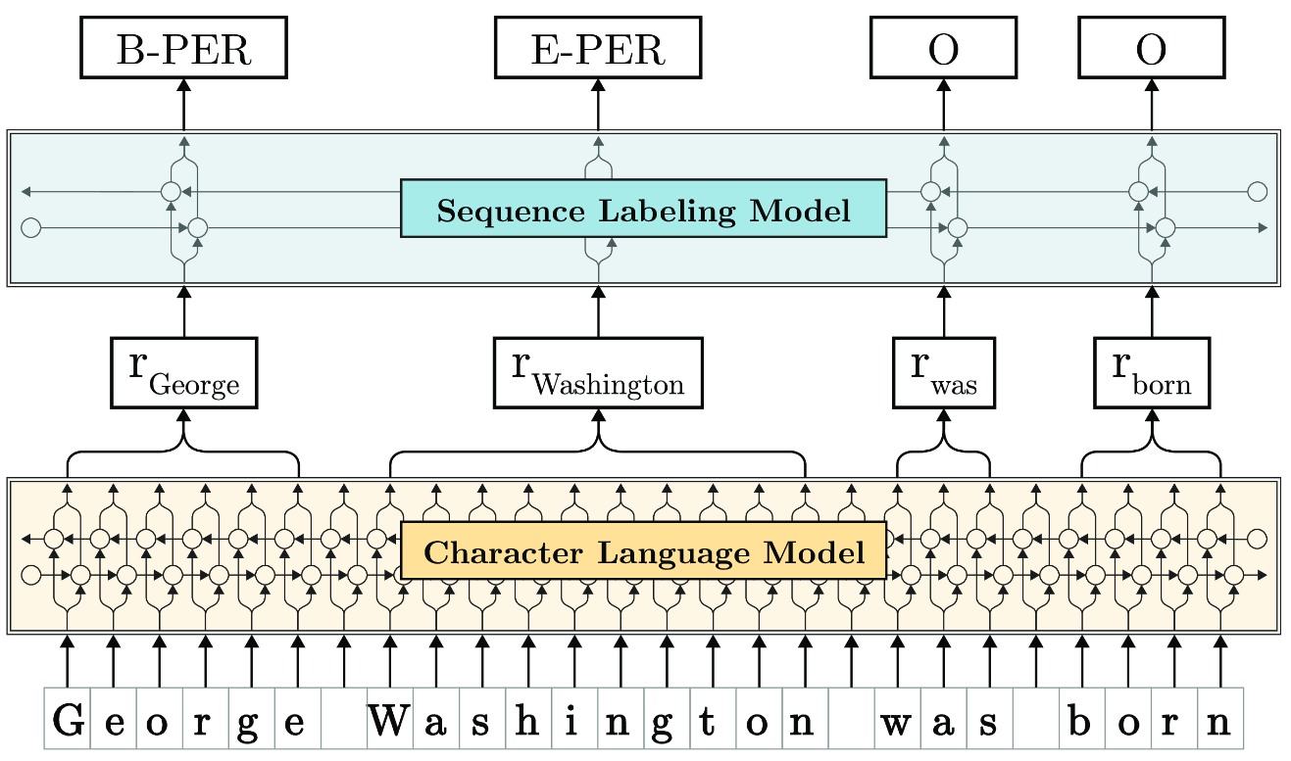
FLAIR
Powerfull framework which utilizes different models and approaches
Supports many types of text analysis, including sequence labeling, text classification, similarity learning and text regression.
Supports many embeddings including GloVe, FastText, ELMo, BERT, XLM, Byte Pair Embeddings and of course our own Flair embeddings:
Includes a „model zoo” of pre-trained models ready to use.
Multilingual

Slide 25
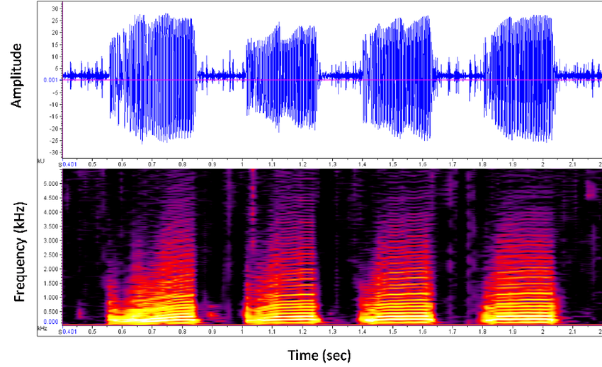
SPEECH EMOTION DETECTION
Typically deep neural networks
Features might be:
Raw audio files
(mel)Spectrograms
MFCCs
Embeddings (e.g. created from self-supervised wav2vec2.0)
|Emotions | > |Sentiments|
Emotions involve anger, disgust, fear, happiness, pleasant surprise, sadness, and neutral. But might include also e.g. frustration. (Dataset dependent)

Slide 26
Q & A

